Slide 1
Enhanced Automatic DNN Acceleration
Rana Elnaggar, Mengyun Liu, Naman Jain
04/26/2018

Slide 2
Outline
I. Motivations of Improving Automatic DNN Acceleration on FPGA
II. Replicating DnnWeaver Framework
III. Accelerate DNN Computing with Encoding Method
IV. Simulation Results
V. Future Works

Slide 3
Motivations
DNN is widely used
FPGA provides an attractive acceleration solution:
Compared with GPU: lower power consumption
Compared with ASIC: lower design effort
Automation tools further reduce design effort:
map neural network to FPGA

Slide 4
II. Replicating DnnWeaver Framework
Replicate DnnWeaver Environment to improve upon it
Run the accelerator synthesis
Configure FPGA with bitstream and run arm interface code to pass inputs and weights of the model under acceleration

Slide 5
Experimental Setup
Zedboard with FPGA SoC
FPGA SoC is needed because the code depends that PS passes the inputs and weights through the interface
Connection options:
Directly boot petalinux (precompiled image) and deal with it (took us long trial and error to realize this)
Run Linux application in Vivado SDK
Cross compilation is challenging
Require tcf agent and server to be setup
To enable tcf agent petalinux need to be built from sources

Slide 6
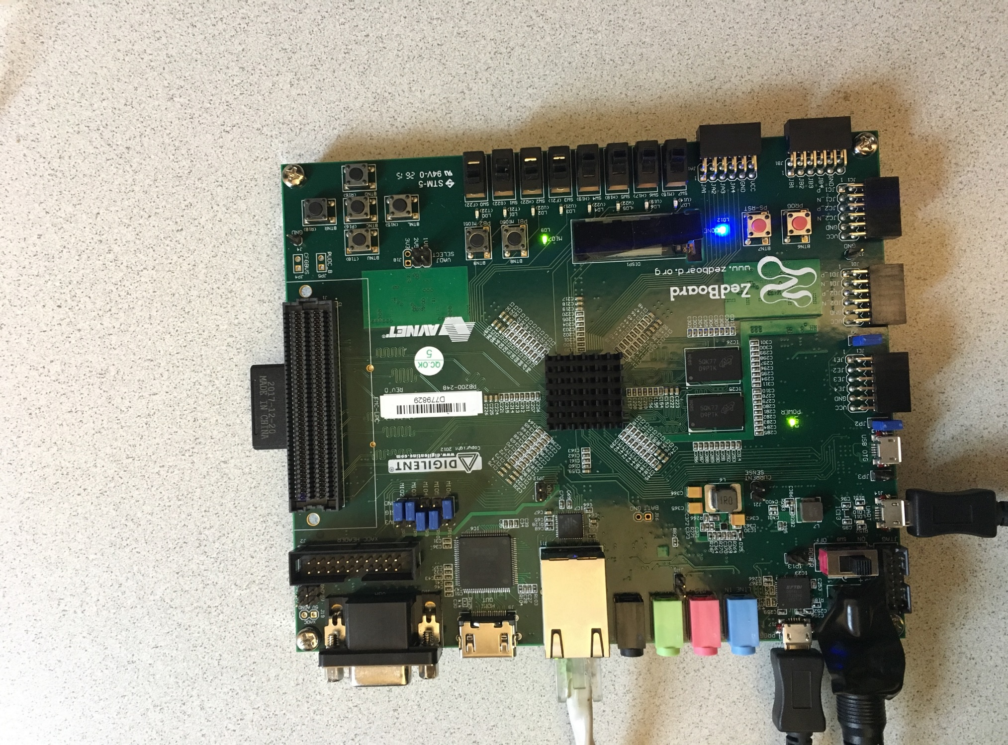
Experimental Setup
Connect to host PC via serial port
Use PUTTY to get output from board
Configure Bitstream using SDK before running arm-software code interface

Slide 7
DNN Weaver High-level Structure
Shared Memory
Input.bin
weight.bin
Controlling SW
ARM PS
ARM PL

Slide 8
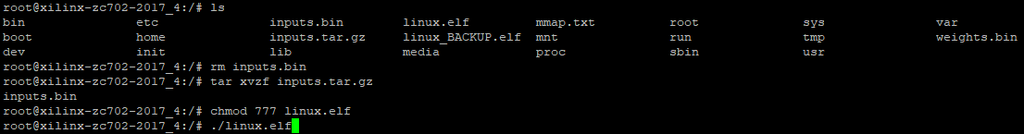
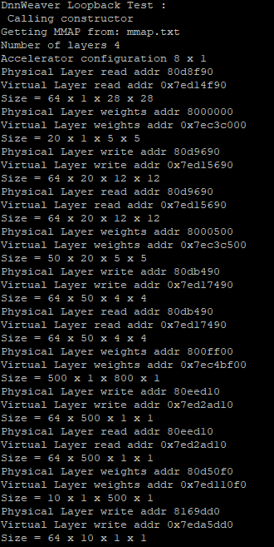
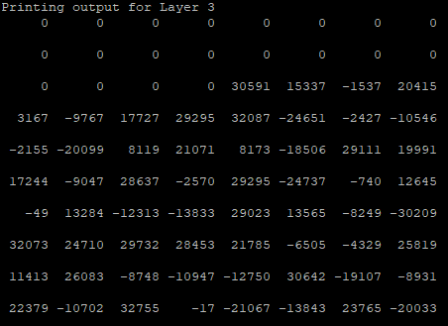
DNN Weaver Output
Call command
Mmap.txt
Output of layers

Slide 9
Dataset Guidelines for the project
According to the generated mmap.txt, following were the requirements:
28x28 image size
20 Convolution filters, each of 5x5 size
Use ReLU activation function followed by 2x2 max pooling in both x and y directions
This is followed by 50 convolution filters, also of 5x5 size with same act. function and pooling
After this, there’s a fully connected layer with 500 units and same act. function.

Slide 10
Training and generating files
Using these details, training was done in python using keras and theano.
As the original dataset is a flat list of 784 vectors, we reshaped the data into 28x28 dimension images
Then, we split the data into training and testing and assigned the relevant labels
SGD was used with a learning rate of 0.01
Training was done for 20 epochs

Slide 11
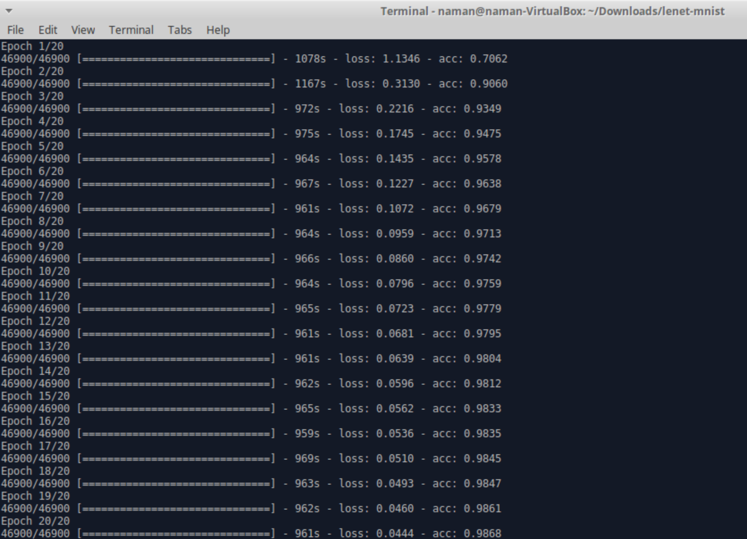

Slide 12
III. Accelerate CNN Computing with Encoding Methods
Existing encoding methods
Stripes: bit-serial CNN computing
Bit-pragmatic CNN computing
Proposed bit-complementary encoding method
Approximation of bit-complementary encoding method
Optimum approximation
Fast approximation

Slide 13
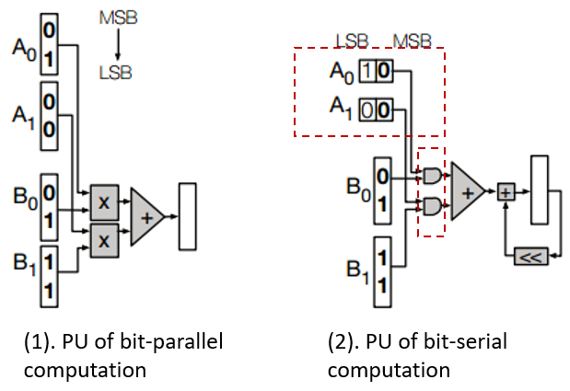
Existing Encoding Method 1
Speedup = 16/p,
P is the bit-width of neurons
Stripes: Bit-serial DNN computing
Challenge:
Waste time on computing ‘0’s
(1). Bit-Parallel Computation: (DaDianNao)
fixed length for both neurons and synapses
use multipliers
(2). Bit-Serial Computation: (Stripes)
fixed length for synapses
use AND gates

Slide 14
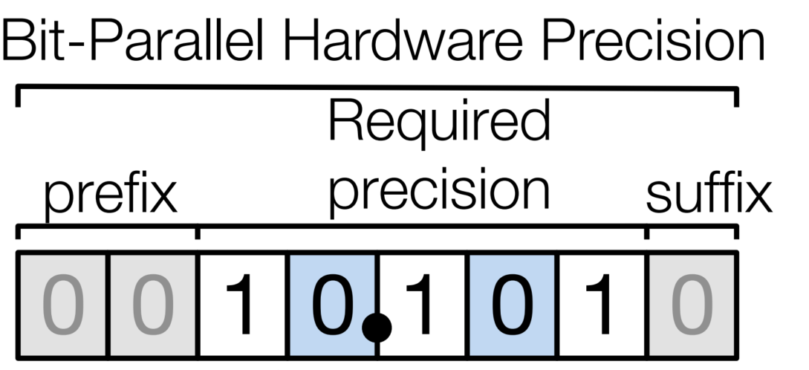
Existing Encoding Method 2
Bit-pragmatic DNN computing
Skip Excess of Precision (EoP)
Skip Lack of Explicitness (LoE)
Express only essential bits
Challenges:
Not suitable for the expressions with lots of ‘1’s,
e.g., 255 = 11111111
Each neuron has different number of essential bits,
hence a synchronize mechanism is needed
EoP
LoE
Essential bits
(1, -1, -3)

Slide 15
Proposed Bit-Complementray Encoding Method
Bit-complementary Encoding:
If there are relatively less ‘1’s than ‘0’s in the expression, we record the position of ‘1’s (same as the pragmatic-encoding method)
E.g., 132 = 10000100 ➔ 1:(7,2)
If there are relatively more ‘1’s than ‘0’s in the expression, we record the position of ‘0’s
E.g., 254 = 11111110 ➔ 0:(0)
Speedup potential of the proposed method:
Neuron = 254
Pragmatic-encoding: 254 = 11111110 ➔ 7 shift add operations
Bit-complementary Encoding:
254 = 11111110 = 11111111 – 00000001 = (100000000-1)-000000001 ➔3 shift subtract operations
Challenge
Need synchronization
1 op + 1 op + 1op

Slide 16
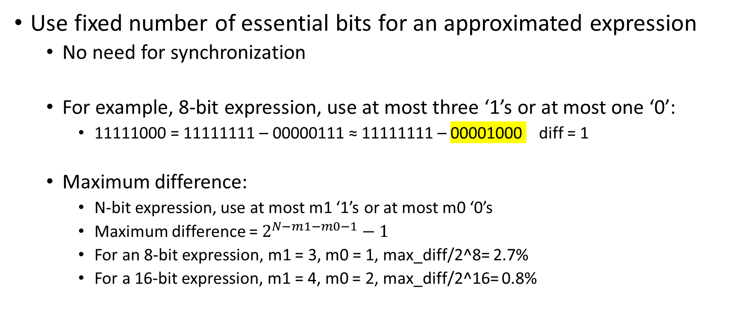
Proposed Encoding Method: optimum approximation
Use fixed number of essential bits for an approximated expression
No need for synchronization
For example, 8-bit expression, use at most three ‘1’s or at most one ‘0’:
11111000 = 11111111 – 00000111 ≈ 11111111 – 00001000 diff = 1
Maximum difference:
N-bit expression, use at most m1 ‘1’s or at most m0 ‘0’s
Maximum difference = $2^{N−m1−m0−1}−1$
For an 8-bit expression, m1 = 3, m0 = 1, max_diff/2^8= 2.7%
For a 16-bit expression, m1 = 4, m0 = 2, max_diff/2^16= 0.8%
High time complexity: O(2^(n-m1-m2))

Slide 17
Proposed Encoding Method: fast approximation
Express only the significant essential bits.
For example, 8-bit expression, m1 = 3, m0 = 1:
Record ‘1’s: 11111000 ≈ 11100000 diff = 11000
Record ‘0’s: 11111000=11111111-00000111
≈11111111-00000100 diff = 11
low time complexity: O(m1+m0)
 |  | N=8, m1=3, m0=1 | N=16, m1=3, m0=1 | N=16, m1=4, m0=2
Optimum-approximation | Maximum diff | 7 | 2047 | 511
 | Average diff | 1.55 | 436.02 | 102.60
Fast-approximation | Maximum diff | 7 | 2047 | 511
 | Average diff | 1.96 | 615.80 | 144.94

Slide 18
IV. Simulation Results
Simulation setup
Preliminary simulation results: accuracy
Preliminary simulation results: computing cost

Slide 19
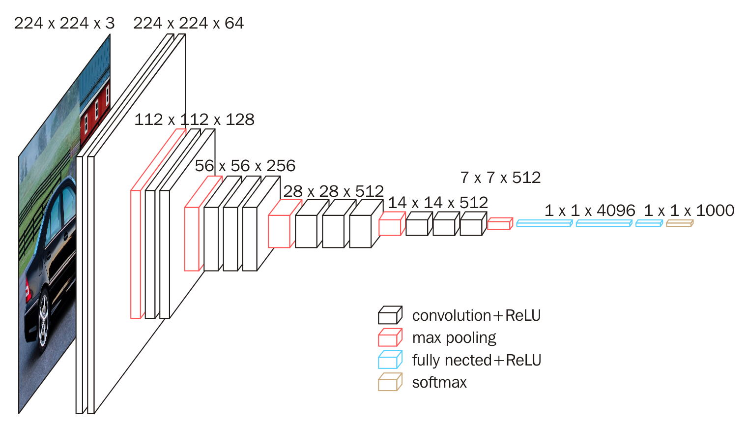
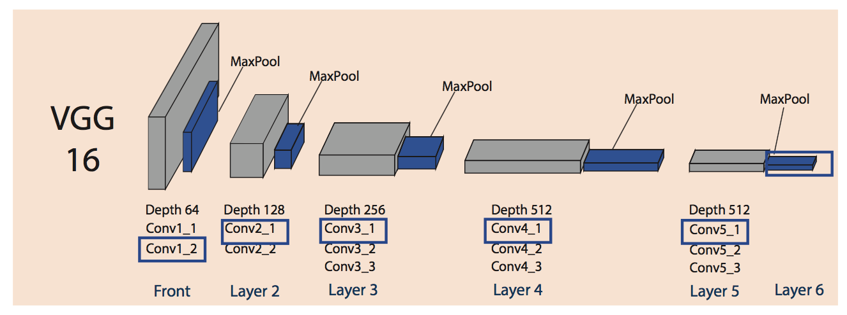
Simulation Setup
Load pre-trained weights of VGG16 in Keras
Extract weight of each layer
Build models for each layer
Get output of each layer
Path through encoding function
Feed output to next layer

Slide 20
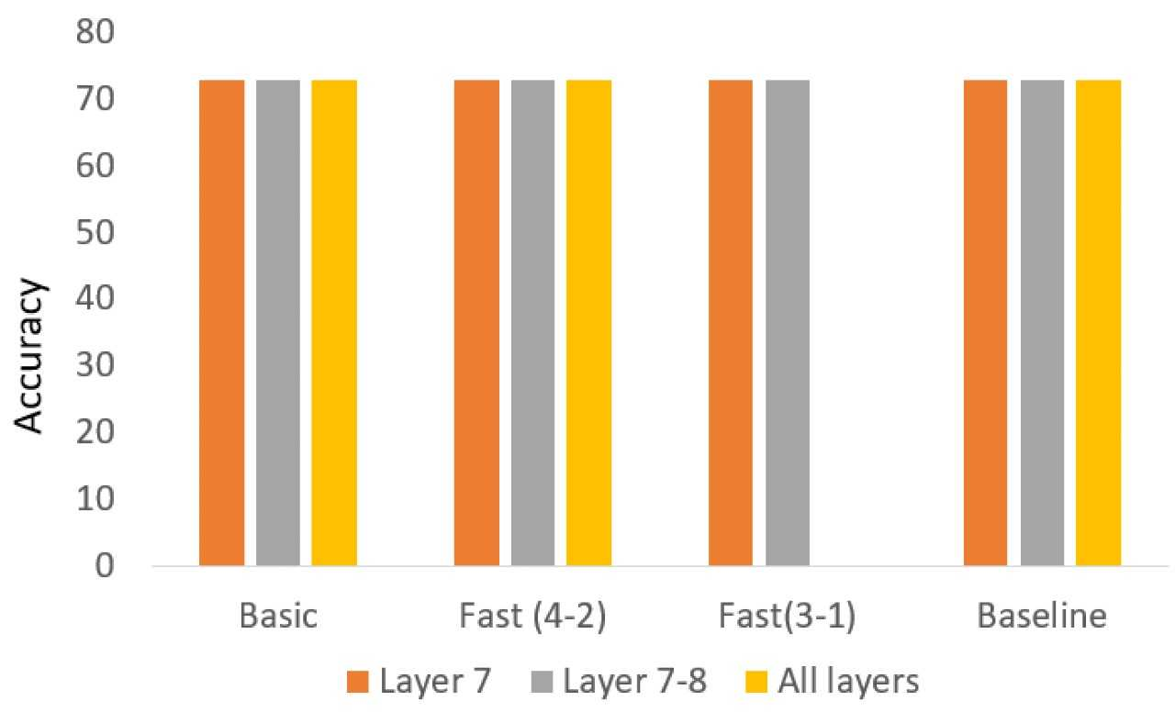
Simulation Results: Accuracy
Almost the same with different types of encoding
Almost similar to original VGG16 settings without encoding

Slide 21
Simulation Results
Comparison of computing cost in the metric of number of operations required
 | Conv1_2 | Conv2_1 | Conv2_2 | Conv3_1 | Conv3_2 | Conv3_3 | Conv4_1 | Conv4_2 | Conv4_3 | Conv5_1 | Conv5_2 | Conv5_3 | all layers
Pragmatic Encoding (Num. Ops) | 9.32E+08 | 5.16E+08 | 9.21E+08 | 2.60E+08 | 3.88E+08 | 3.96E+08 | 9.34E+07 | 1.30E+08 | 1.01E+08 | 1.88E+07 | 1.63E+07 | 1.18E+07 | 3.78E+09
Complementary Encoding (Num. Ops) | 7.96E+08 | 3.66E+08 | 6.09E+08 | 1.62E+08 | 2.43E+08 | 2.42E+08 | 5.55E+07 | 8.18E+07 | 6.67E+07 | 1.32E+07 | 1.26E+07 | 9.89E+06 | 2.66E+09
Reduction | 14.65% | 29.09% | 33.81% | 37.88% | 37.54% | 39.04% | 40.62% | 36.93% | 33.73% | 29.73% | 22.90% | 16.38% | 29.81%
*Did not compare the cost of encoding (future work)

Slide 22
Future Works
Improve the encoding mechanism to handle negative values
Design hardware to implement bit-complementary encoding on-fly
Modify the “PE.v” file to integrate the new design to DnnWeaver
Run simulations on more datasets and more network structures

Slide 23
Q&A
Thank you for listening!

Slide 24
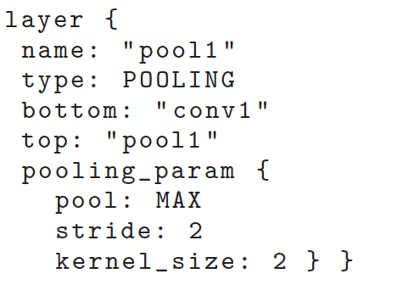
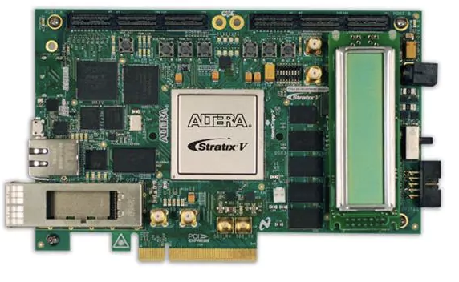
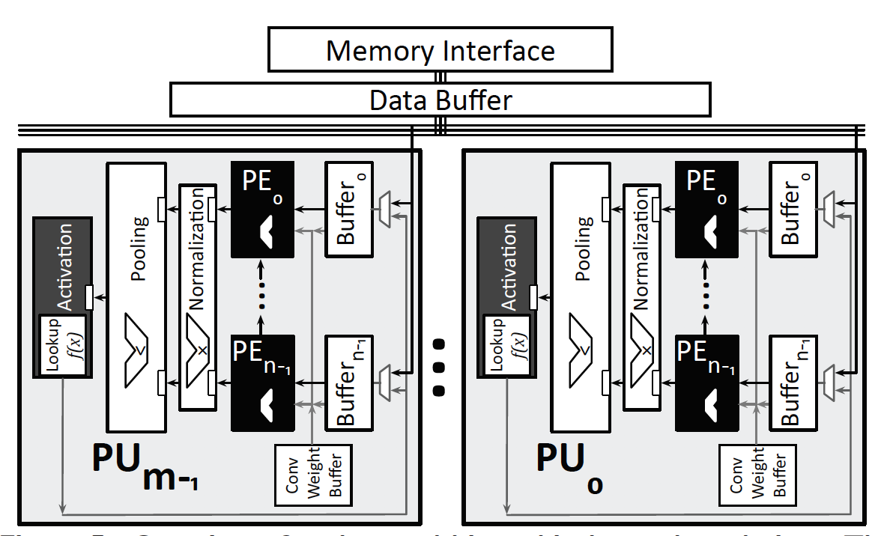
DnnWeaver flow
“prototxt”
Generic templates
FPGA SPECs
Execution Schedule
ISA Mapping
Design Planner
Design Weaver
Resource Allocation
ISA Macro dataflow diagram
Memory
interface
Integrator
Synthesizable accelerator
Zync_wrapper.bit
Memory

